Slide 1
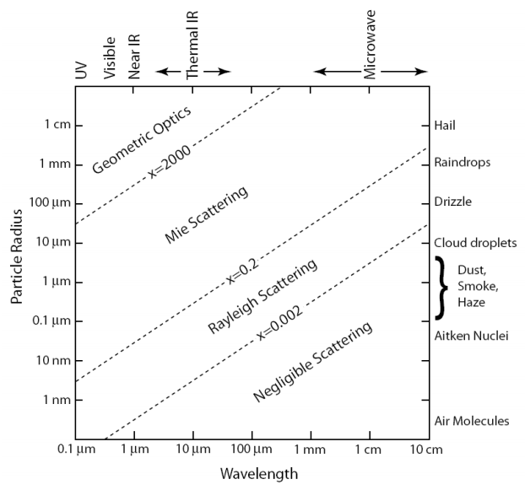
PM10
PM2.5
VIS
NIR
FIR

Slide 2
VIS

Slide 3
原始反射頻譜
亮度歸一化之反射頻譜

Slide 4
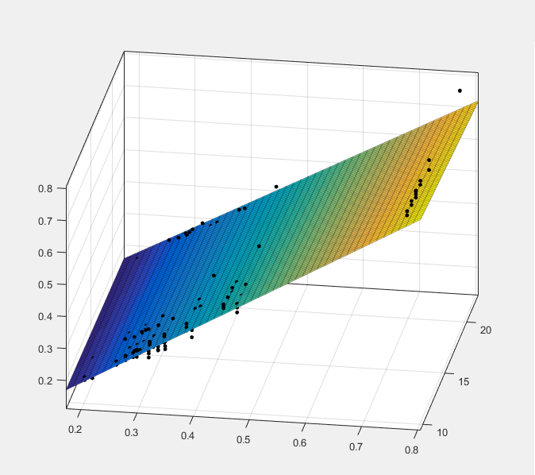
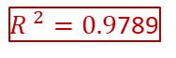
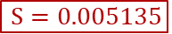
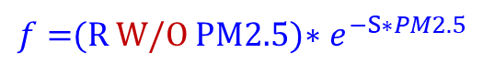
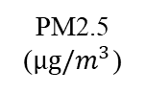
$f=$(R W/O PM2.5)$∗e^{−S∗PM2.5}$
${R }^{2}=0.9$789
$$S=0.005135$$
Integral reflectance (a.u.)
PM2.5
($μg/m^{3}$)
Reflectance without PM2.5 (a.u.)

Slide 5
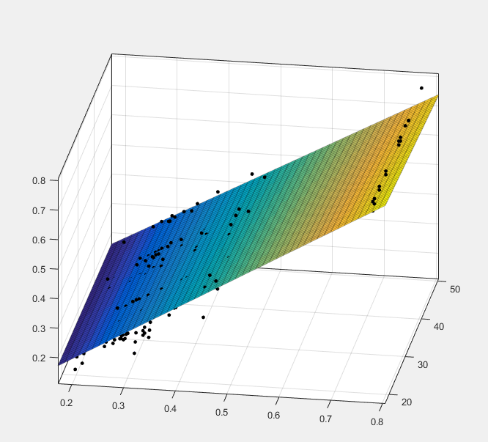
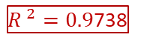

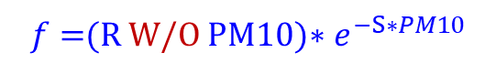
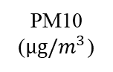
$f=$(R W/O PM10)$∗e^{−S∗PM10}$
${R }^{2}=0.9$738
$$S=0.001837$$
Integral reflectance (a.u.)
PM10
($μg/m^{3}$)
Reflectance without PM10 (a.u.)

Slide 6
5/13 PM2.5
5/13 PM10

Slide 7
6/28 PM2.5
6/28 PM10

Slide 8
6/29 PM2.5
6/29 PM10

Slide 9
NIR

Slide 10
原始反射頻譜
亮度歸一化之反射頻譜

Slide 11
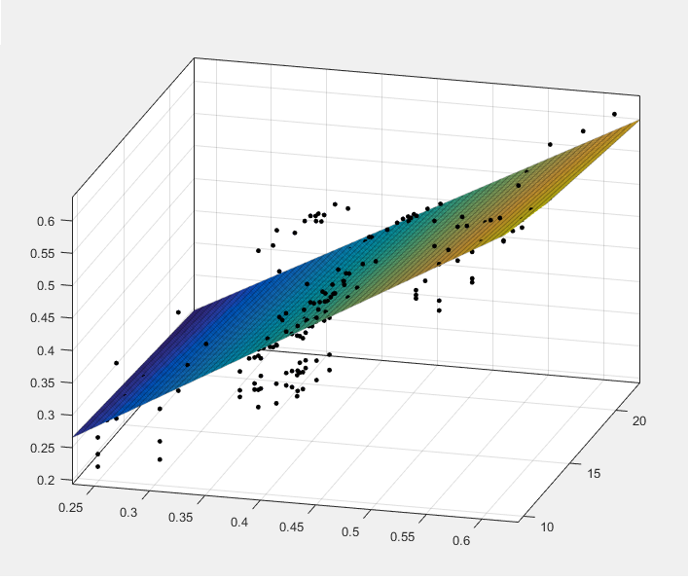

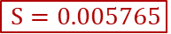
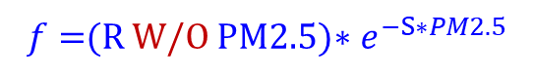
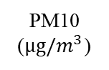
$f=$(R W/O PM2.5)$∗e^{−S∗PM2.5}$
$${R }^{2}=0.6919$$
$$S=0.005765$$
Integral reflectance (a.u.)
PM10
($μg/m^{3}$)
Reflectance without PM2.5 (a.u.)

Slide 12
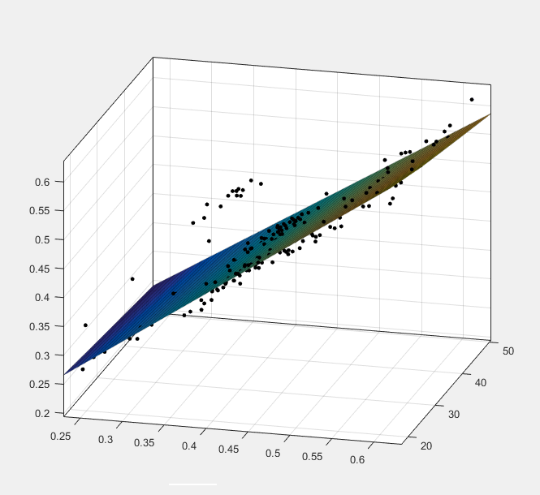

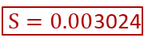
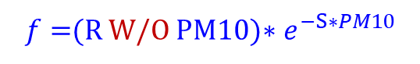
$f=$(R W/O PM10)$∗e^{−S∗PM10}$
$${R }^{2}=0.7803$$
$S=0.00$3024
Integral reflectance (a.u.)
PM10
($μg/m^{3}$)
Reflectance without PM10 (a.u.)

Slide 13
5/13 PM2.5
5/13 PM10

Slide 14
6/28 PM2.5
6/28 PM10

Slide 15
6/29 PM2.5
6/29 PM10

Slide 16
FIR

Slide 17
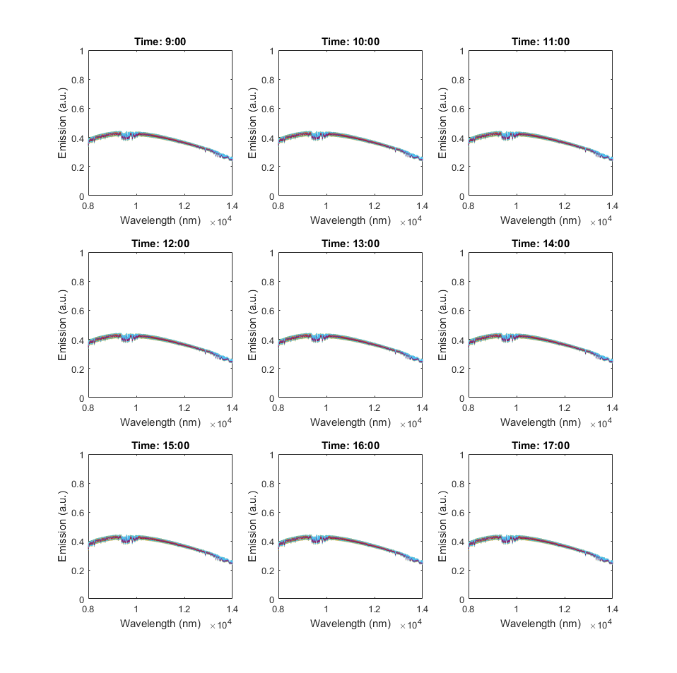
原始反射頻譜
亮度歸一化之反射頻譜

Slide 18
5/13 PM2.5
5/13 PM10

Slide 19
PM2.5
5/13
6/28
6/29
VIS
NIR

Slide 20
PM10
5/13
6/28
6/29
VIS
NIR

Slide 21
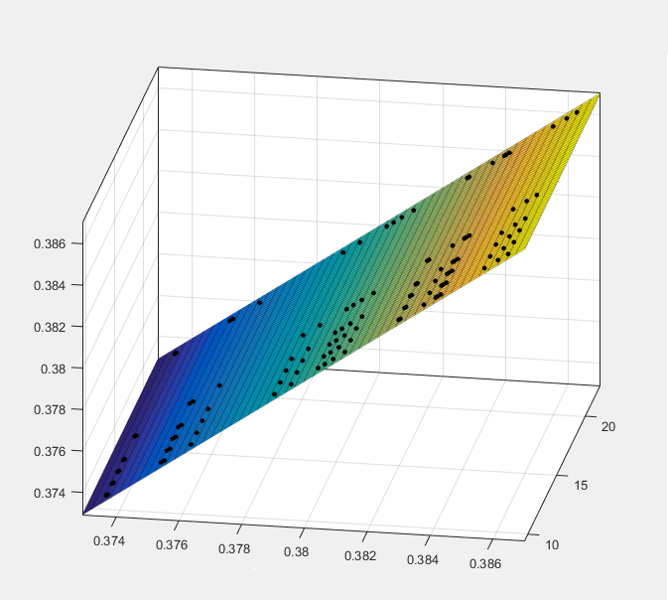


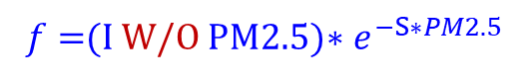
$f=$(I W/O PM2.5)$∗e^{−S∗PM2.5}$
$${R }^{2}=1$$
$$S=1.902×{10}^{−8}$$
Integral Intensity (a.u.)
PM2.5
($μg/m^{3}$)
Intensity without PM2.5 (a.u.)

Slide 22
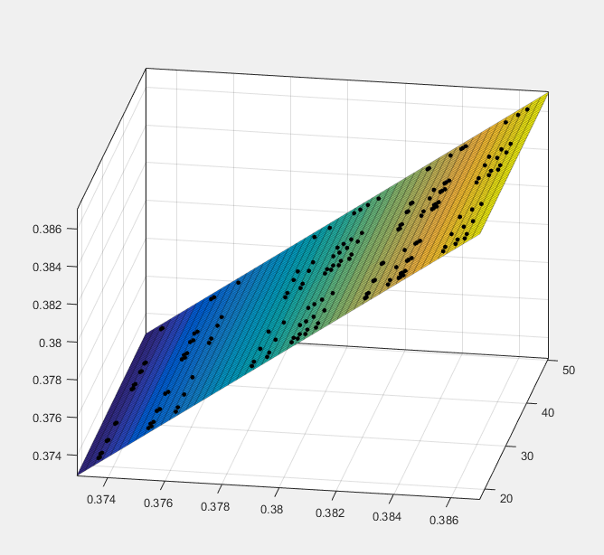

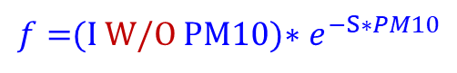
$f=$(I W/O PM10)$∗e^{−S∗PM10}$
$${R }^{2}=1$$
$$S=7.482×{10}^{−9}$$
Integral Intensity (a.u.)
PM10
($μg/m^{3}$)
Intensity without PM10 (a.u.)

